Slide 1

Amazon Sales Report Dashboard Development
-DEEPENDRA KUMAR
Comprehensive Analysis and Visualization
Date: 23rd Aug. 2024

Slide 2
AGENDA
Problem Statement​
SLICERS REQUIREMENT
KPI’s Requirement
Chart Requirement
Software Used
​​Summary

Slide 3
PROBLEM STATEMENT
Analyze Amazon sales transaction data to extract actionable insights into sales performance. The project involves creating interactive Power BI visualizations to explore trends, identify top and worst-performing categories, understand sales patterns, and more.
Additionally, I will be verifying the results with SQL queries to ensure data accuracy and consistency.
This problem will work as a reference that will help to make decisions, optimize product catalogue, marketing strategies, and overall operational efficiency.

Slide 4
Kpi’s requirement
Total Sales Amount: Measure the overall revenue generated from sales amount.
Total Quantity Ordered: Track the total number of Qty sold.
Total Orders Placed: count of distinct order ID to assess order volume.

Slide 5
Chart requirement
Sales Trends:
Daily Sales Trend: Line or area chart showing total sales amount per day.
Monthly Sales Trend: Line or bar chart illustrating total sales amount per month.
Sales Distribution:
Top 10 Cities by Total Sales: Bar chart or map visualization showing sales distribution by city.
Top 10 States by Total Sales Amount: Bar chart or map visualization showing sales distribution by state.

Slide 6
Chart requirement^{[cont.]}
Product Performance:
Top 5 Products by Revenue, Quantity, and Orders: Bar charts highlighting the top 5 products based on revenue, quantity ordered, and total orders.
Bottom 5 Products by Revenue, Quantity, and Orders: Bar charts showcasing the bottom 5 products with the lowest performance metrics.
Sales by Fulfillment Method:
Percentage of Sales by Fulfillment Method: Pie chart illustrating the distribution of sales across different fulfilment methods.

Slide 7
Chart requirement^{[cont.]}
Sales by Category and Size:
Percentage of Sales by Product Category: Pie chart displaying sales distribution across product categories.
Percentage of Sales by Product Size: Pie chart showing sales distribution based on product sizes.

Slide 8
Software requirement:
MS Office/Excel: Home & Student 2016 Version
PostgreSQL: PostgreSQL 16.4, 08/08/2024 (latest update)
Power BI: 2.132.1053.0 version, 8/21/2024 (published date)

Slide 9
Thank you
Your feedback and questions are welcome.
For Further Clarification, you can contact me through mentioned details:
Contact Name: Deependra Kumar
Email: kumar.deependra073@gmail.com
Feel free to reach out if you have any questions or need additional information

Slide 10
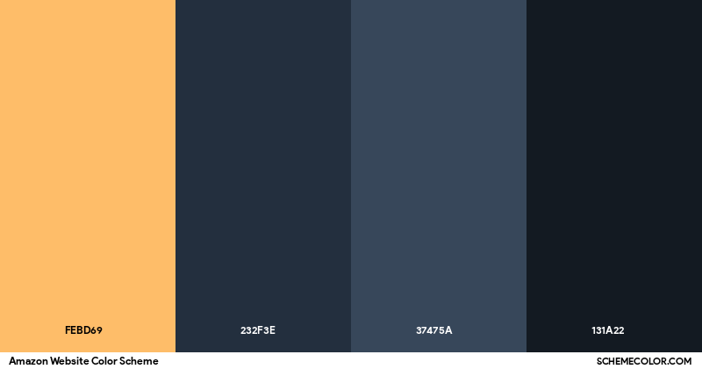
Amazon Website Color Palette Image Format
https://www.schemecolor.com/amazon-website-colors.php

